Slide 1

Exploring Student Performance: An EDA
This presentation provides an exploratory data analysis (EDA) of a dataset related to student performance in secondary education. We will delve into various attributes, including demographic details, family background, educational support, lifestyle choices, and academic performance, to uncover key insights.
SC
by Sarthak Chaudhary

Slide 2

Dataset Overview
The dataset comprises 649 entries and 33 columns, with each row representing a unique student. It includes both categorical and numerical data types, covering aspects from school and sex to academic grades (G1, G2, G3).
school
649
object
sex
649
object
age
649
int64
address
649
object
famsize
649
object
The dataset is complete with no null values, ensuring robust analysis. We've separated columns into categorical and numerical for focused univariate and bivariate analysis.

Slide 3
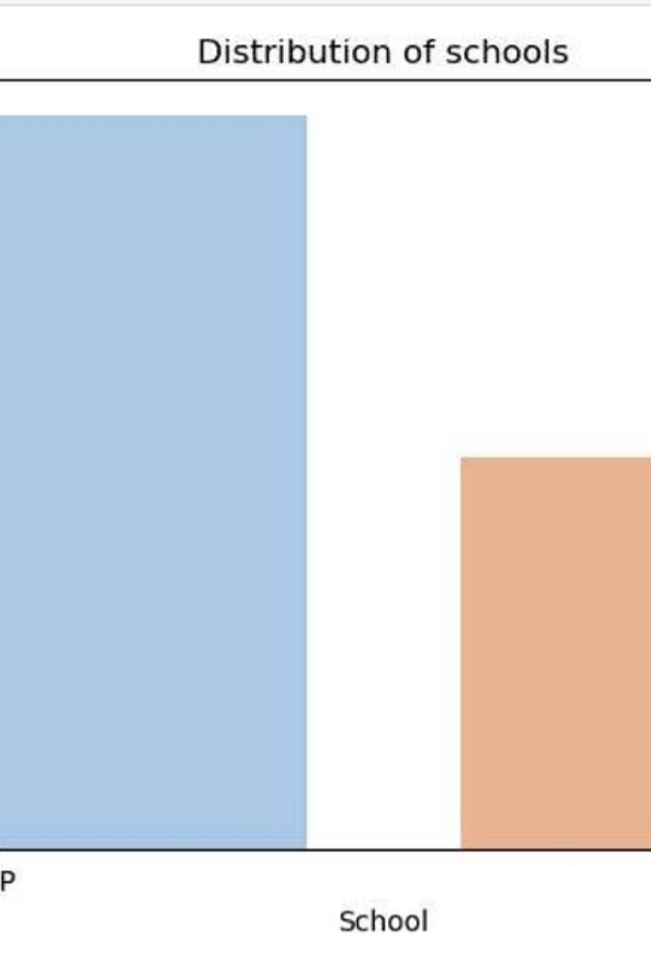
Student Demographics
School Distribution
GP school has a significantly higher number of students (423) compared to MS school (226).
Age Group
Most students fall within the 15-18 age range, indicating a skewed distribution towards younger ages.
Residential Area
The majority of students reside in urban regions, suggesting a predominantly urban student population.

Slide 4
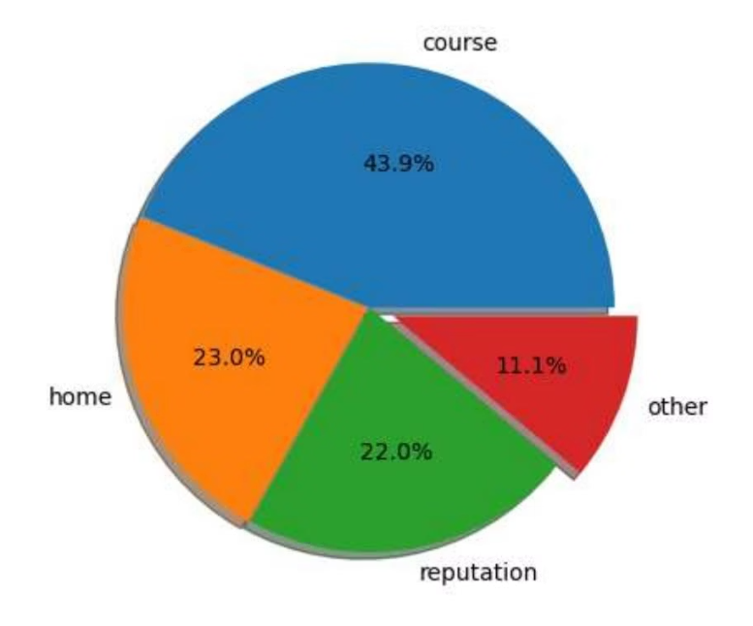
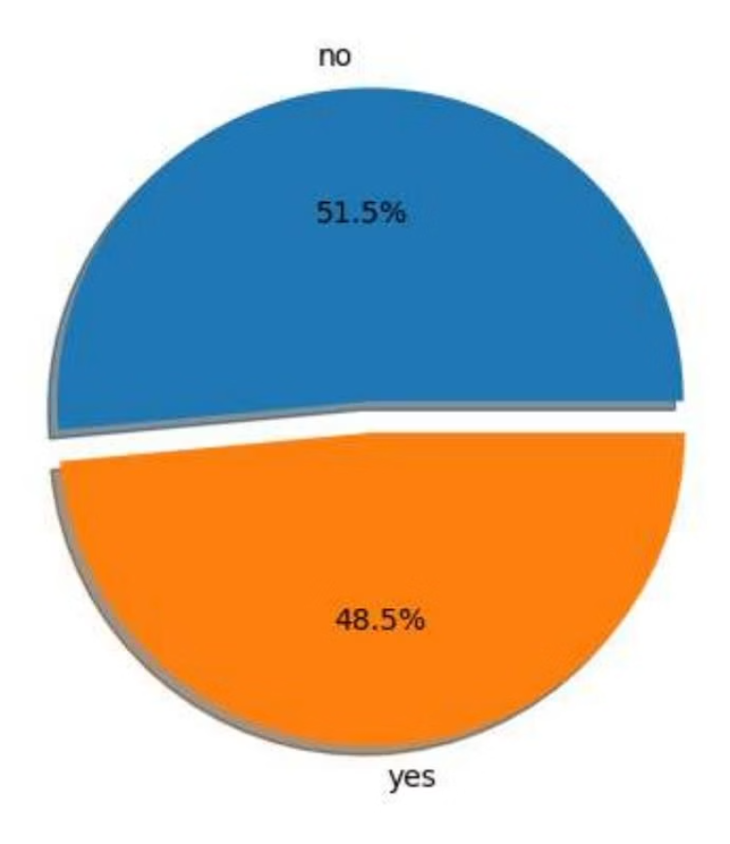
Reasons for School Choice & Activities
Primary Reason
The most common reason for students to choose their school is the course itself, accounting for 43.9% of responses.
Other reasons include home proximity, school reputation, and miscellaneous factors.
Extracurricular Activities
A significant portion of students, 48.5%, are engaged in extracurricular activities, while 51.5% are not.

Slide 5
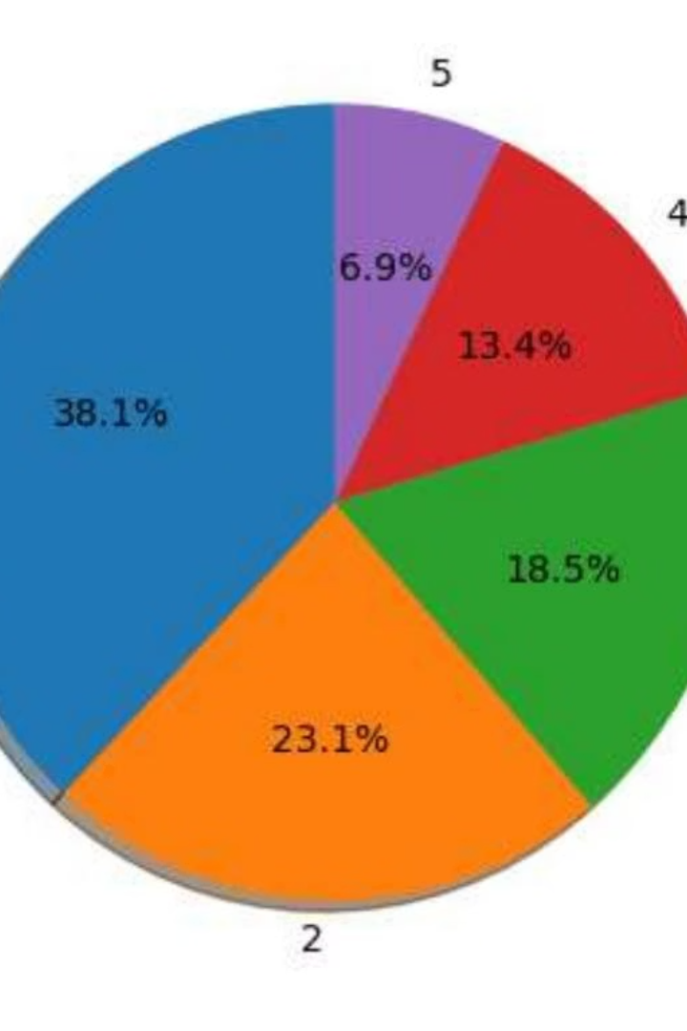


Alcohol Consumption Habits
Weekly Consumption
Daily Consumption
Only 6.9% of students consume alcohol 5 times per week, indicating that high weekly consumption is not widespread.
A larger proportion, 69.5% of students, report daily alcohol consumption, which is a notable finding.

Slide 6
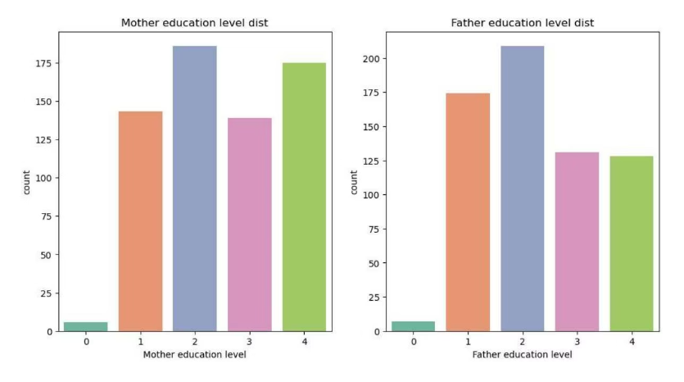
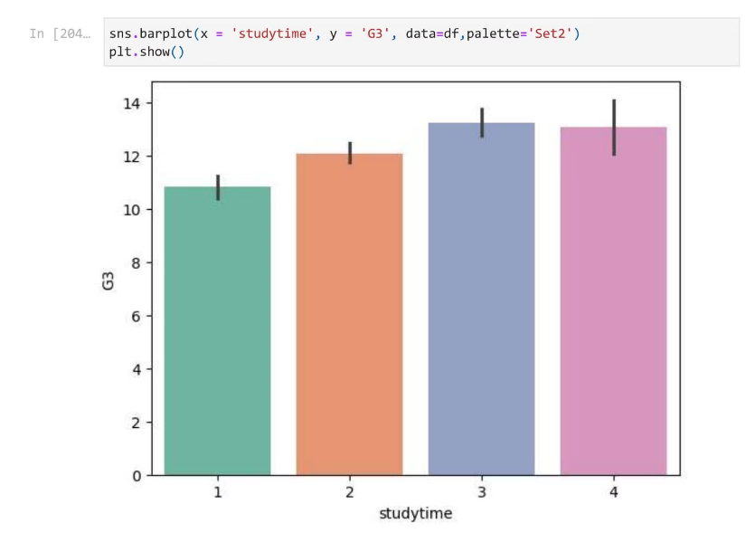
Parental Education & Study Time Impact
Parental Education Levels
Study Time vs. Marks
Mothers generally have higher education levels compared to fathers, as observed in the distribution.
Students who study for one hour achieve an average of 11 marks. This increases to 12 marks for two hours of study and 13 marks for three hours, showing a positive correlation.

Slide 7
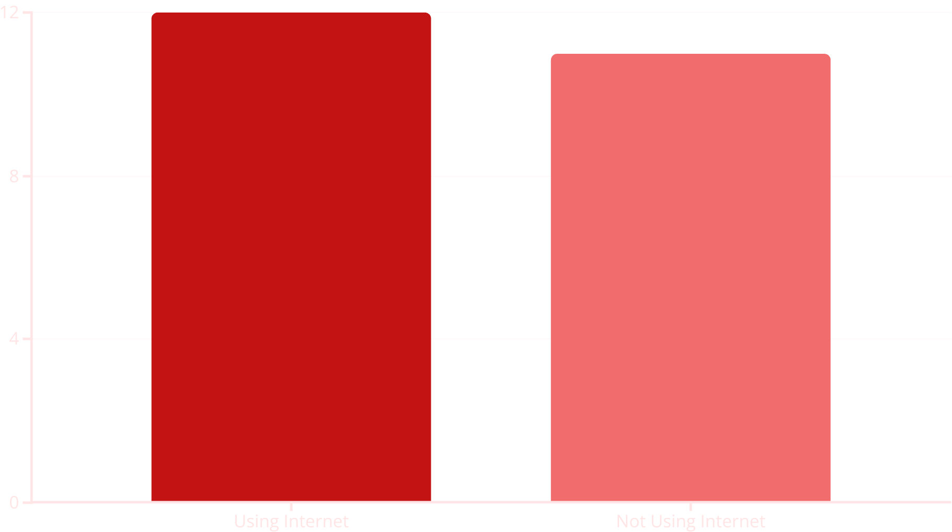
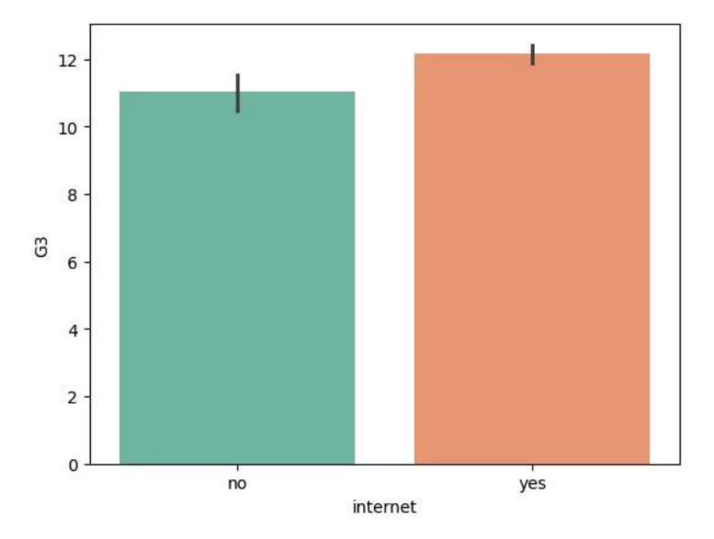
Internet Usage & Academic Performance
Students who use the internet tend to score higher, with an average of 12 marks, compared to 11 marks for those who do not use the internet. This suggests a potential positive impact of internet access on academic performance.

Slide 8




Key Takeaways & Next Steps
Urban Students Excel
North urban males and females consistently achieve higher average marks, indicating a potential correlation between address and academic success.
Median Age & Outliers
The median age of students is 17, with some outliers in travel time, study time, and absences that warrant further investigation.
Correlation Insights
A heatmap reveals strong positive correlations between G1, G2, and G3 grades, and negative correlations between failures and grades.

